Slide 1
Debris in Space Autonomous Removal Mechanism (DISARM)
Matthew Intriago
Client: Dr.Wilde • Advisor: Dr.Silaghi • 8/30/2020

Slide 2
Project Members
CSE Team
AEE Team
AEE Team
Matthew Intriago
Control Subsystem Supporting Engineers
Nouraldean El-Chariti
Mike Leard
Daniel Soto
Project Manager
Kyle Watkins
Project Systems Engineer
Luca Rizza
Electronics
Mike Leard
Ali Lebbar
Davey Reinoid
Grappling Mechanism
Daniel Soto
Laura Guziczek
Structures
Vincent Panicelli

Slide 3
Goal
Provide a tool that improves the safety of all space missions by removing the risk of colliding against space debris.
Not only are future space missions at risk, but also all current satellites that are orbiting our atmosphere are in danger against debris.

Slide 4
Approach
Grappling Device Prototype Autonomy
The grappling device can autonomously perform the welding process.
When objects collied, the device can transfer collision data such as velocity and momentum of the space debris.
Grappling Device Prototype Manual Mode
The device shall be able to provide an accessible interface for power and data transfer.
Users can check status of welding completion with aircraft
If autonomy fails, users can manually cancel or shut off the welding process.
Using the collected data that is transferred to the user-interface, users can adjust the grappling hook to fix the errors that occur during autonomy.

Slide 5
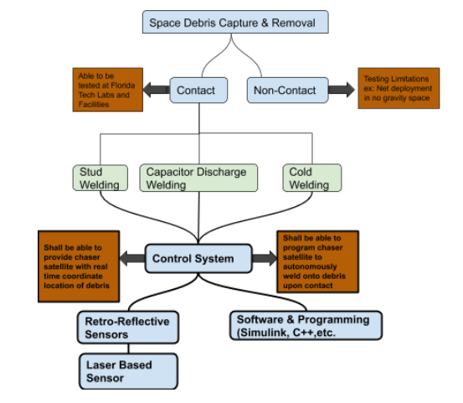

Slide 6
Technical Challenges
The programing of the microcontrollers such as Arduino or Raspberry Pi to connect the algorithm in use to the grappling hook itself.
The designing of the interface that will demonstrate the user the power and data transfer of the welding process.
The design of the autonomous algorithm that will adapt to different types of debris welding.

Slide 7
Milestone One
Select Microcontroller tool (Arduino or Raspberry Pi)
Provide small ("hello world") demo(s) to evaluate the tools
Resolve technical challenges:
Microcontroller effectiveness with algorithm
Decide in the language for the user-friendly interface
Design an outline of the autonomous algorithm
Compare and select collaboration tools for software development
Create Requirement Document
Create Design Document
Create Test Plan

Slide 8
Milestone Two
Have a fully designed autonomous algorithm to be tested on the microcontroller that will be used on the grappling hook.
Once designed and tested, fix bugs that might show up after testing.
Develop a demo removal of space debris to display the features of the algorithm.
Locate the appropriate software to use for the graphical simulation of the demo algorithm.

Slide 9
Milestone Three
Have a designed interface that will allow for a user-friendly usage of the grappling hook and data collected.
Test the user-interface, making sure that the grappling hook is collecting and transferring accurate data of velocity and momentum.
Develop a demo where we test both the algorithm itself using the hook and observe as data is collected on the user-interface.

Slide 10
Thank you.
Matthew Intriago
Client: Dr.Wilde • Advisor: Dr.Silaghi • 8/30/2020

